Slide 1

Maryland Electronic Payment Issuance Card Program
Maryland Joint Child Support Council
Annual Conference and Training Seminar
Doris N. Dixon, Director, Senior Prepaid Card Specialist
October 22, 2019

Slide 2
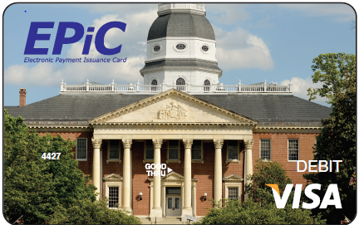
Agenda
Your Bank of America team
Our leadership and innovation working for you
Commitment to Prepaid
Electronic Payment Issuance Card (EPiC) Program history
The cardholder experience
Market shift to mobile
Questions

Slide 3

Your Bank of America team
State of Maryland Client Manager
Tammy Kennedy-Nichols
Senior Client Manager responsible for the State of Maryland relationship
tammy.kennedynichols@bofa.com
*All inquiries from the field are funneled through the SDU
Prepaid Client Support
Day to day support for PAT and PRT inquiries
prepaidclientsupport@bankofamerica.com
Prepaid Card Specialist
Prepaid Card Specialist
Strategic support on program enhancement
Doris N. Dixon
doris.n.dixon@bofa.com
EXTENDED TEAM
Prepaid Card Account Manager
Sabrina Clark
sabrina.clark@bofa.com
An experienced, dedicated team backed by
strong, reliable resources.

Slide 4
Our leadership and innovation working for you
COMPREHENSIVE OFFERING
  Drive value into your organization through our ability to match your payment needs to best-in-class payment solutions and technology.*
We are committed to the prepaid industry
RELATIONSHIP BANK
  Collaborate confidently knowing that our holistic approach to meeting your financial needs – offering treasury and other services – means we know and understand your business.
DEDICATED SERVICE
  Receive support when and where you need it from U.S.-based teams dedicated to our clients and empowered to assist cardholders.
INVESTMENT AND INNOVATION
  Focus on providing sustainable programs while we maintain a stable and consistent platform through active investment in our prepaid card products, our people and new technologies and bring you the latest in card innovation.
*BAML Commercial Prepaid’s government programs are consistently rated as the best programs in the nation by consumer advocacy group National Consumer Law Center
Notes:
27,000 card programs across the globe
20,000 clients globally

Slide 5
Commitment to Prepaid
Global brand recognition.
Strong national footprint.
20+ years
$20bn
TOP FOUR ISSUER
COMMERCIAL PREPAID
PROGRAMS
2019 Nilson Report
Experience in prepaid solutions
Disbursed annually
99.99%
25mm
BEST IN THE INDUSTRY
PREPAID GOVERNMENT
PROGRAMS
2017 Survey, National Consumer Law Center
Authorization uptime
Transactions processed monthly
$110+mm
100%
GREATEST GAINS
AUTHORIZATION APPROVAL RATE, POS USAGE, PORTFOLIO GROWTH AND GROSS FRAUD RATE REDUCTION
2018 VISA DPS Client Achievement Awards
Invested since 2010
Call Center availability
Strong relationships and understanding of regulatory environment
Industry-leading reputation and world-class service capabilities
Zero Liability Coverage*, FDIC insured accounts
Fair and reasonable cardholder fees
Largest bank-owned ATM network with 16,000+ locations nationwide
Strengths
*subject to certain terms and conditions set forth in the cardholder agreement

Slide 6
EPiC Program history
Supporting Department of Human Resources since 2002
2013 Electronic Payment Issuance Card Program Launch
2018 Issued close to 7,000 new EPiC accounts
2018 Disbursed over $222.8MM to parents
Prepaid Mobile App Launch
CashPay Launch
EPiC Program Launch
Mobile Enhancements
2002
Q2 2013
Q3 2018
Q4 2019
Early adopter to the issuance of child support payments via Prepaid Card
Project start Q2 2012
DHR shift to total electronic payments
Customized program name, card and materials
Mobile app allowing cardholders to access account information, ATM locators, suspend/reactivate cards and manage alerts
Spanish language and additional fraud alerts added to Mobile App
Mobile wallet functionality allowing cardholders to add their EPiC account to their preferred wallet

Slide 7
The cardholder experience

Slide 8
Valuable benefits of prepaid cards for cardholders
Purchase Power
Usable everywhere Visa debit cards are accepted – in stores, online or by phone
Easy Access
Cash access is available at 16,000+ Bank of America ATMs - 227 in MD, cash back at point of sale locations and teller cash access at Visa financial institutions
Time Savings
Cardholders have near immediate access to their funds. Activate cards immediately and have 24/7 access to available balance
Cost Savings
Check-cashing costs are eliminated
Funds Security
Zero Liability Coverage means owners of lost or stolen cards may be reimbursed for unauthorized card transactions*
      Customer Service
    24/7 account information online or via toll-free number or mobile app
*subject to certain terms and conditions set forth in the cardholder agreement

Slide 9
EPiC Custom Marketing Materials

Slide 10
EPiC Welcome Packet Materials

Slide 11
EPiC Fee Schedule

Slide 12
EPiC
24/7 U.S.-based cardholder service and support
Cardholder Website
Card activation
Select Personal Identification Number (PIN)
Check balance
View transaction history
Change PIN
Obtain dispute forms
Locate an ATM
Perform online funds transfer transactions
Frequently asked questions
Language support in English and Spanish
IVR
Toll-free
Language support in English and Spanish
Card activation
Select Personal Identification Number (PIN)
Check account balance
Check date/amount of last deposit
Change PIN
Check recent transactions
Opt to speak to a customer service representative
Live Customer Service
Toll-free line
TTY line for hearing impaired
Language support in English and Spanish
Card activation
Change name and address
Request transaction history
Investigate transactions
Process lost/stolen/damaged cards
Request a check
Close accounts
Cardholder Mobile App
Check balance
View transaction history
Set up email/SMS alerts
Locate an ATM
Suspend and reactivate card
Frequently asked questions

Slide 13
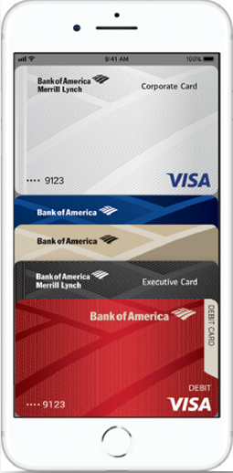
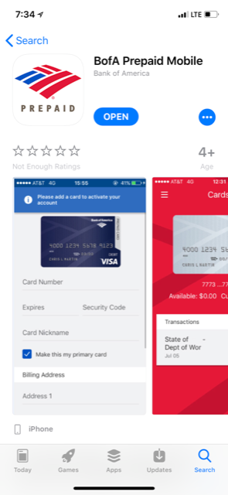
Prepaid Mobile App
Features and functionality
Information in the palm of your hand
View Balances: Gain quick access to balances on all of your Bank of America Merrill Lynch prepaid cards while on the go.
View Transaction History: See each pending and posted transaction and where the transaction took place.
Suspend or Reactivate Cards: Turn your card on/off as needed for security reasons.
Manage Alerts (Email and SMS): Set up alerts to come to you via email or text message for usage, balance and personal information changes.
ATM Locator: Access an interactive map of ATM/Bank locations to find the one most convenient to you along your travels.
Available in the iOS App Store and Google PlayTM store

Slide 14
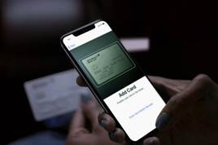




Market shifts towards mobile
We believe more clients could benefit from mobile payment functionality given 78 of the top 100 merchants in the U.S. now accept mobile wallets and the number continues to grow.*
Why do cardholders want mobile wallets?
They are more secure. Every mobile wallet purchase gets a unique, one-time account number that can’t be traced back to your card. Merchants never see your account number. Your info stays private. Mobile wallet transactions are also faster than using a physical card in a terminal.
Where can mobile wallets be used?
Most commonly, our cardholders use mobile wallets to pay for Uber and Lyft rides. The second most common merchant type is restaurants. Additionally, most merchants in airports accept mobile wallet payments.
How does one load a prepaid card to a mobile device?
Adding a prepaid card to a mobile wallet is a snap—literally. Open your phone’s Mobile Wallet app, take a picture of your card (or enter it manually) and verify. You’ll get a notice once your card is active, and then you’re ready to pay.
78
Of the top 100 merchants in U.S. accept mobile wallets*
*Source: Visa Contactless Payments Global Highlights Whitepaper

Slide 15
?

Slide 16
Notice to Recipient
"Bank of America Merrill Lynch" is the marketing name for the global banking and global markets businesses of Bank of America Corporation. Lending, derivatives and other commercial banking activities are performed globally by banking affiliates of Bank of America Corporation, including Bank of America, N.A., Member FDIC. Securities, strategic advisory, and other investment banking activities are performed globally by investment banking affiliates of Bank of America Corporation ("Investment Banking Affiliates"), including, in the United States, Merrill Lynch, Pierce, Fenner & Smith Incorporated and Merrill Lynch Professional Clearing Corp., both of which are registered as broker-dealers and Members of SIPC, and, in other jurisdictions, by locally registered entities. Merrill Lynch, Pierce, Fenner & Smith Incorporated and Merrill Lynch Professional Clearing Corp. are registered as futures commission merchants with the CFTC and are members of the NFA. Investment products offered by Investment Banking Affiliates: Are Not FDIC Insured * May Lose Value * Are Not Bank Guaranteed.
This document is intended for information purposes only and does not constitute a binding commitment to enter into any type of transaction or business relationship as a consequence of any information contained herein.
These materials have been prepared by one or more subsidiaries of Bank of America Corporation solely for the client or potential client to whom such materials are directly addressed and delivered (the “Company”) in connection with an actual or potential business relationship and may not be used or relied upon for any purpose other than as specifically contemplated by a written agreement with us. We assume no obligation to update or otherwise revise these materials, which speak as of the date of this presentation (or another date, if so noted) and are subject to change without notice. Under no circumstances may a copy of this presentation be shown, copied, transmitted or otherwise given to any person other than your authorized representatives. Products and services that may be referenced in the accompanying materials may be provided through one or more affiliates of Bank of America, N.A.
We are required to obtain, verify and record certain information that identifies our clients, which information includes the name and address of the client and other information that will allow us to identify the client in accordance with the USA Patriot Act (Title III of Pub. L. 107-56, as amended (signed into law October 26, 2001)) and such other laws, rules and regulations.
We do not provide legal, compliance, tax or accounting advice.
For more information, including terms and conditions that apply to the service(s), please contact your Bank of America Merrill Lynch representative.
Investment Banking Affiliates are not banks. The securities and financial instruments sold, offered or recommended by Investment Banking Affiliates, including without limitation money market mutual funds, are not bank deposits, are not guaranteed by, and are not otherwise obligations of, any bank, thrift or other subsidiary of Bank of America Corporation (unless explicitly stated otherwise), and are not insured by the Federal Deposit Insurance Corporation (“FDIC”) or any other governmental agency (unless explicitly stated otherwise).
This document is intended for information purposes only and does not constitute investment advice or a recommendation or an offer or solicitation, and is not the basis for any contract to purchase or sell any security or other instrument, or for Investment Banking Affiliates or banking affiliates to enter into or arrange any type of transaction as a consequent of any information contained herein.
With respect to investments in money market mutual funds, you should carefully consider a fund’s investment objectives, risks, charges, and expenses before investing. Although money market mutual funds seek to preserve the value of your investment at $1.00 per share, it is possible to lose money by investing in money market mutual funds. The value of investments and the income derived from them may go down as well as up and you may not get back your original investment. The level of yield may be subject to fluctuation and is not guaranteed. Changes in rates of exchange between currencies may cause the value of investments to decrease or increase.
We have adopted policies and guidelines designed to preserve the independence of our research analysts. These policies prohibit employees from offering research coverage, a favorable research rating or a specific price target or offering to change a research rating or price target as consideration for or an inducement to obtain business or other compensation.
Copyright 2019 Bank of America Corporation. Bank of America N.A., Member FDIC, Equal Housing Lender.

